Slide 1
Clusters Visualization
File created on: 2023/9/21 14:04:04 PDT

Slide 2
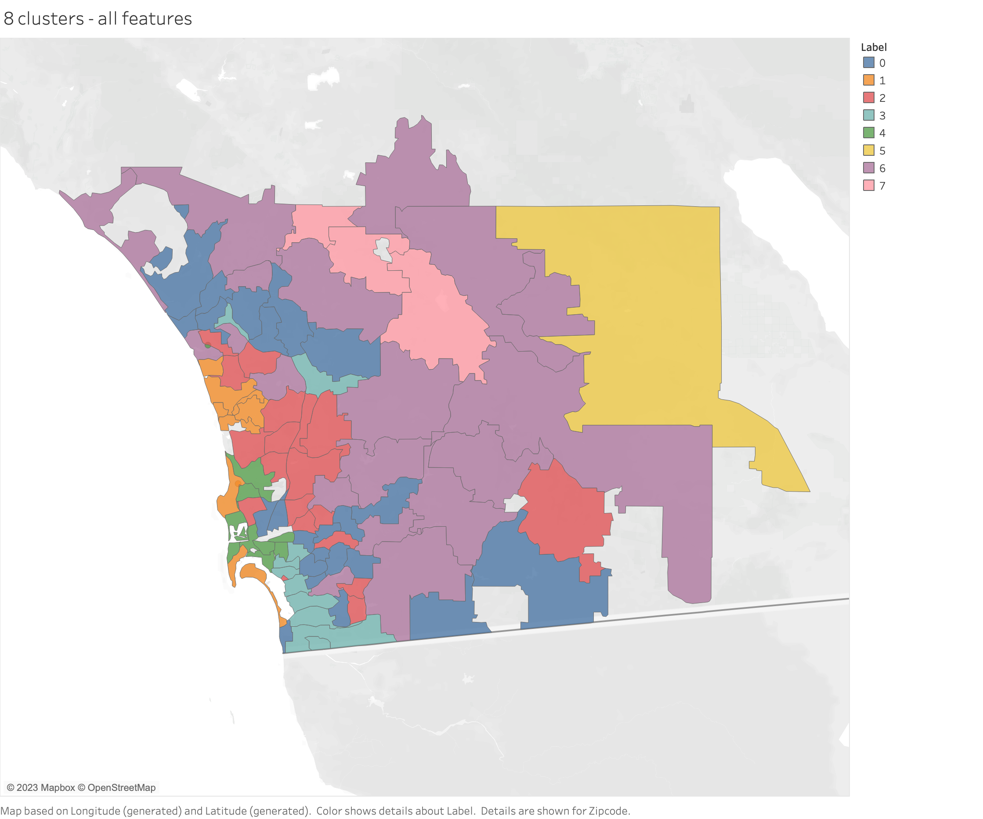

Slide 3
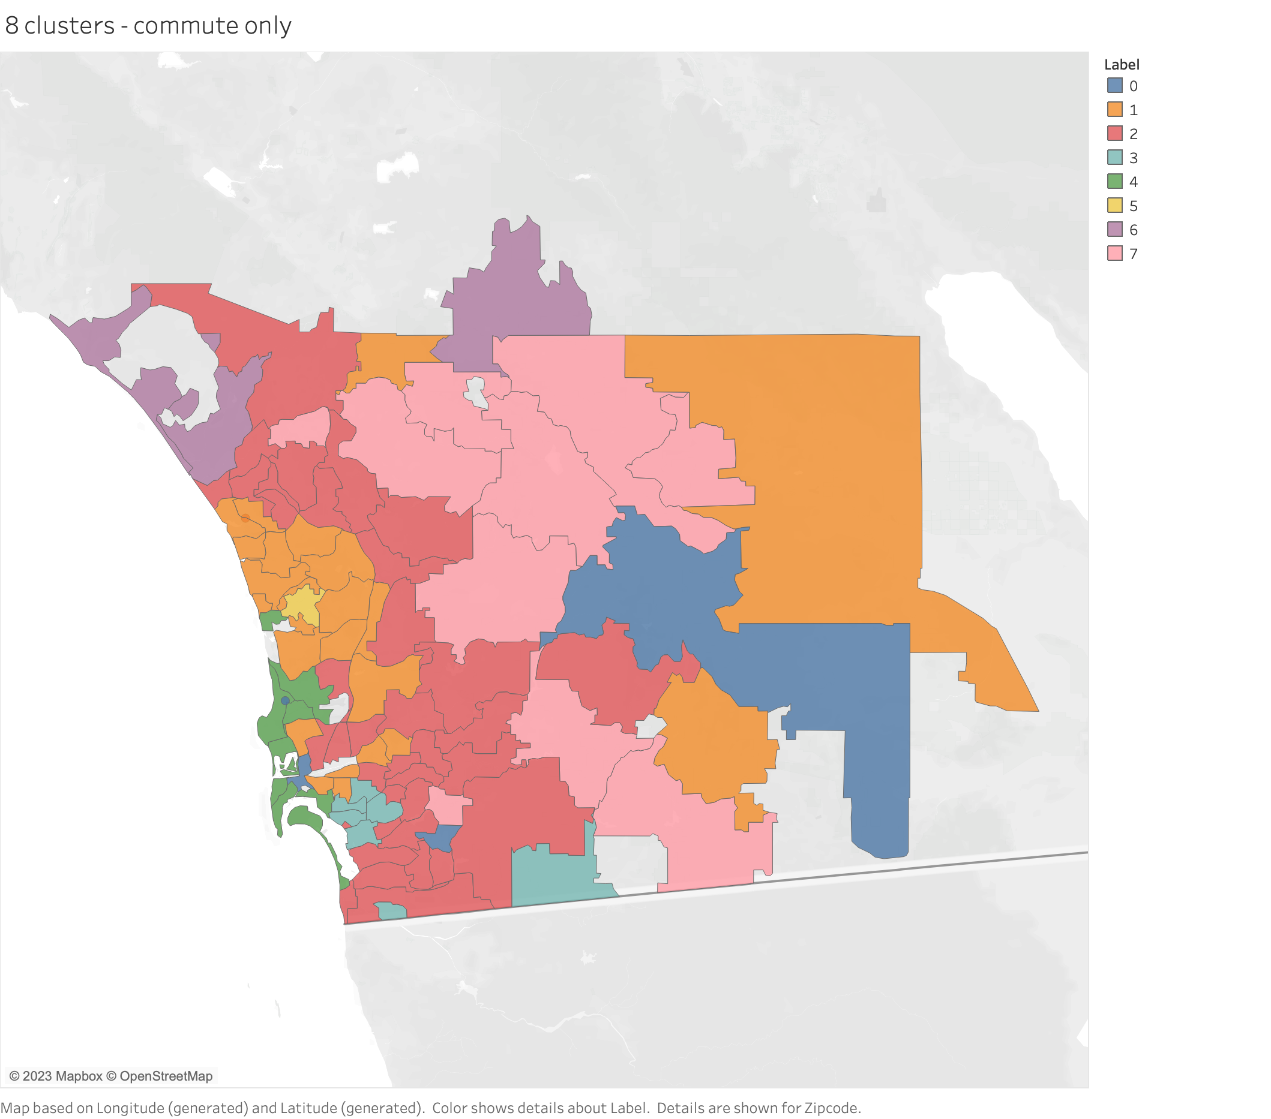

Slide 4
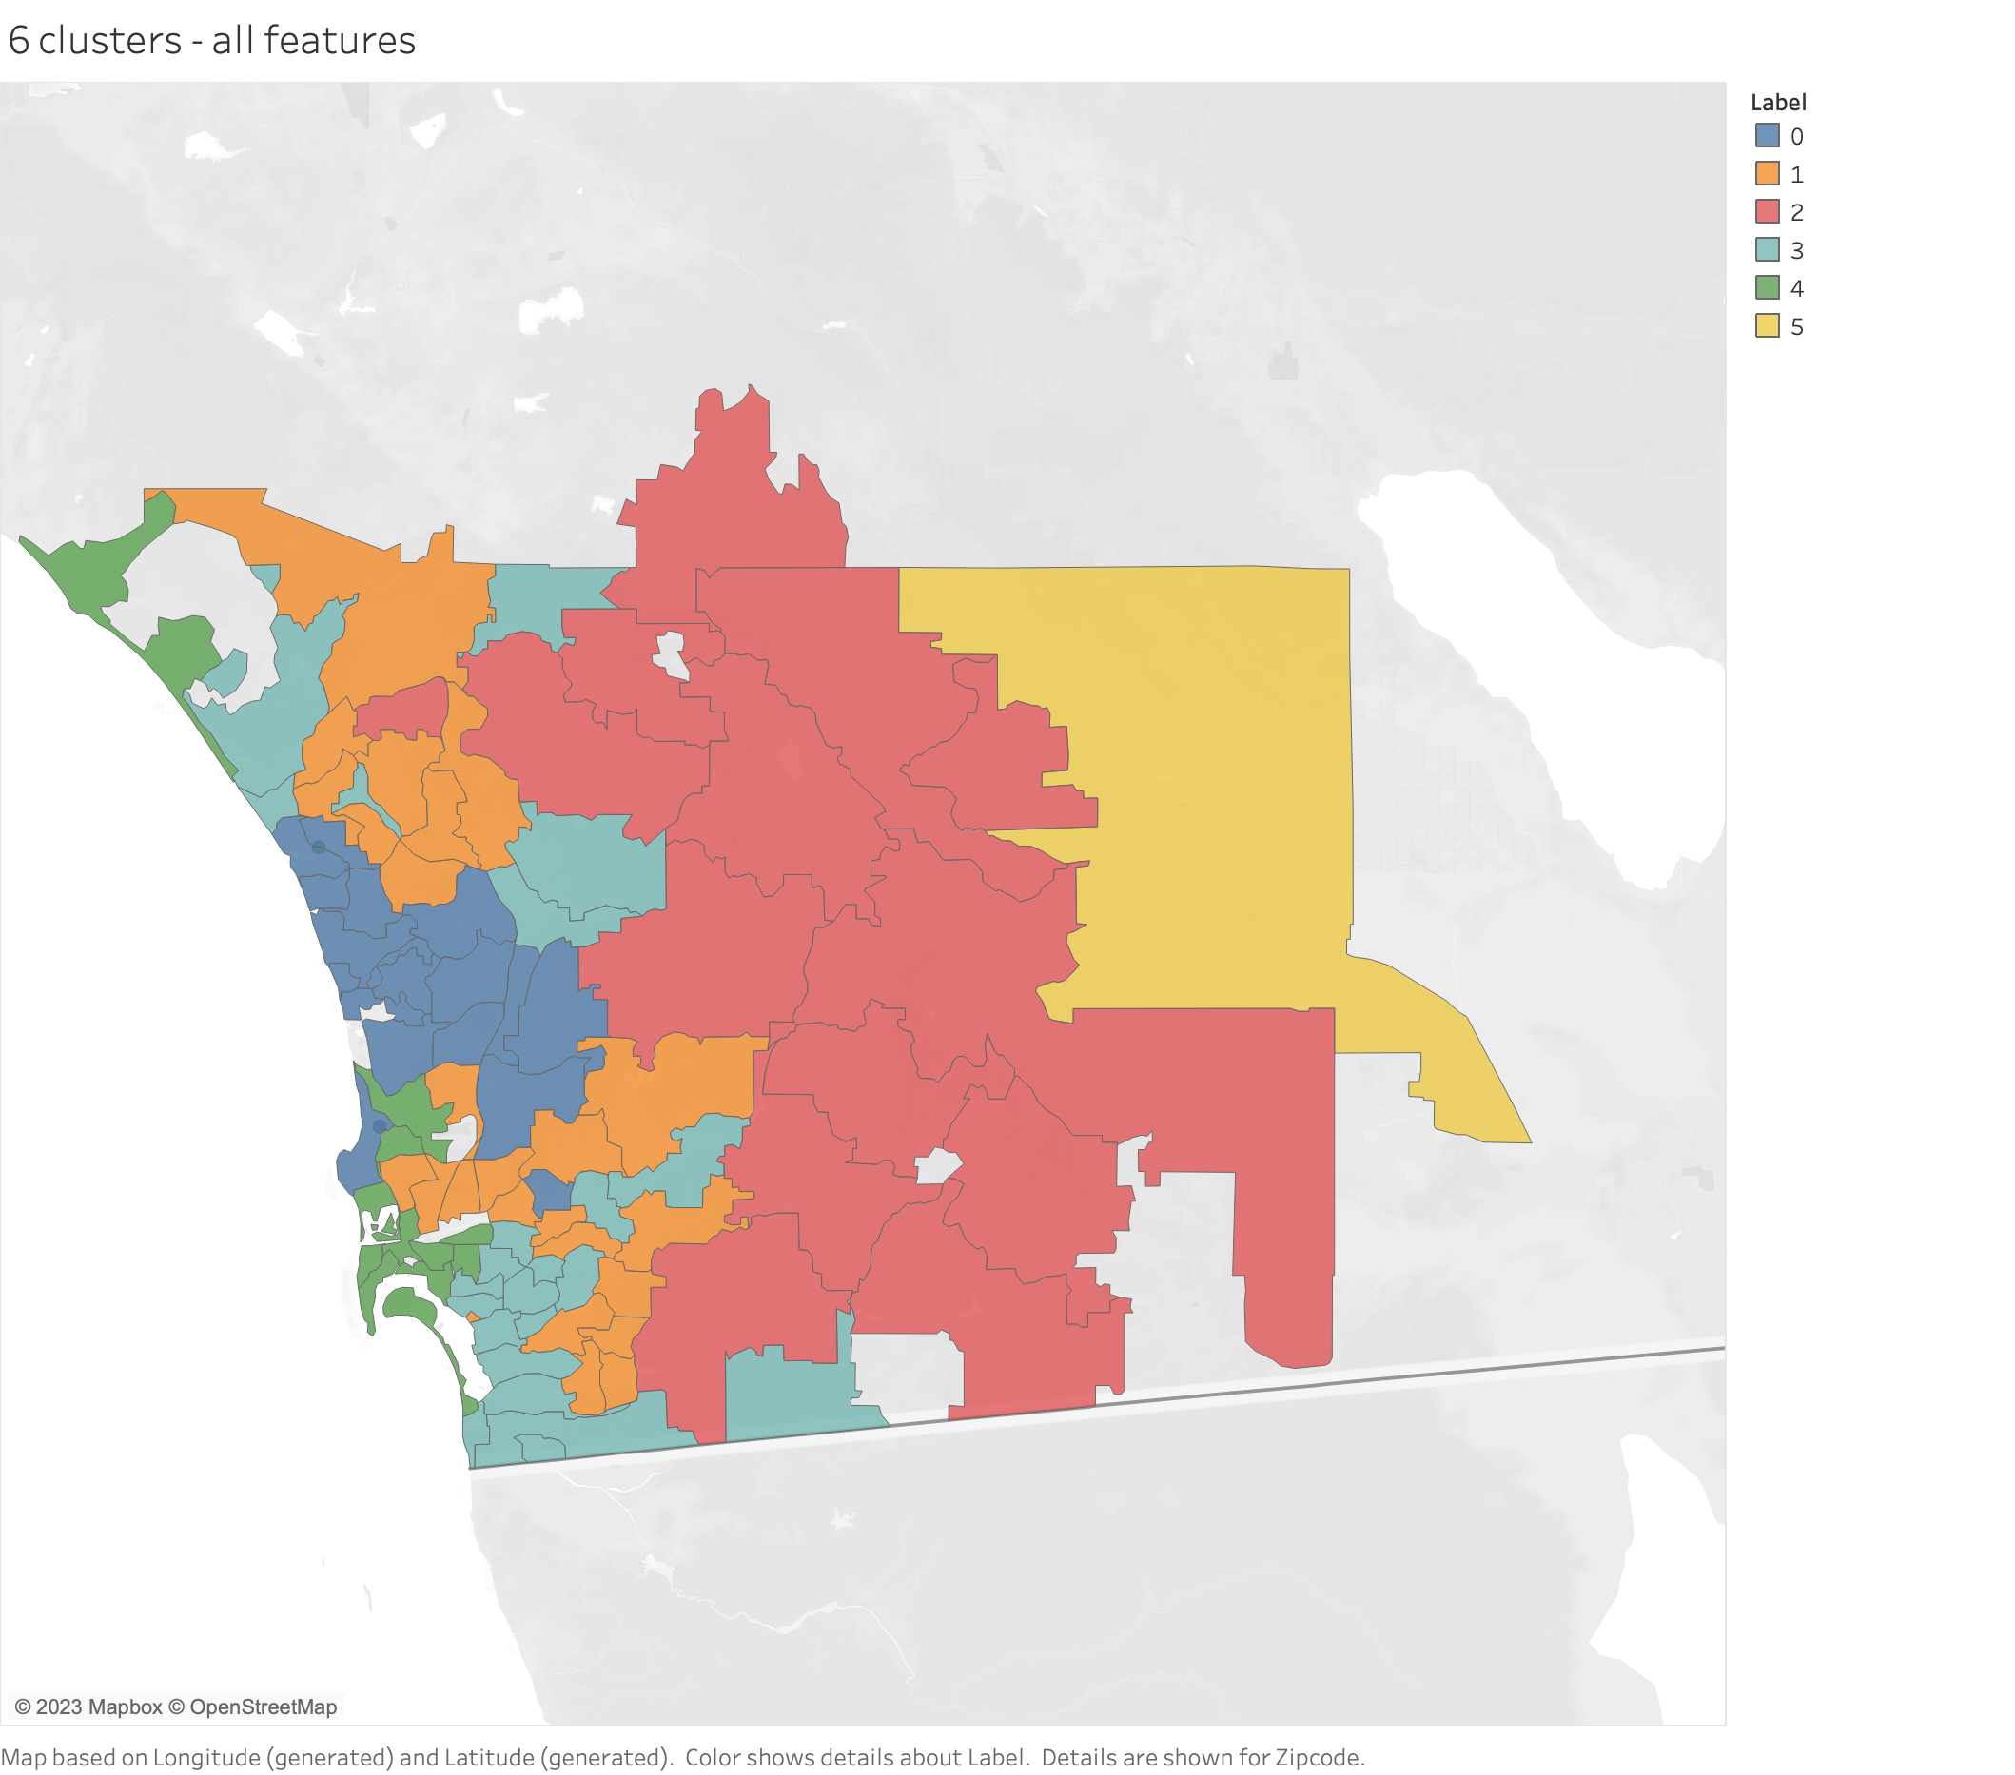

Slide 5
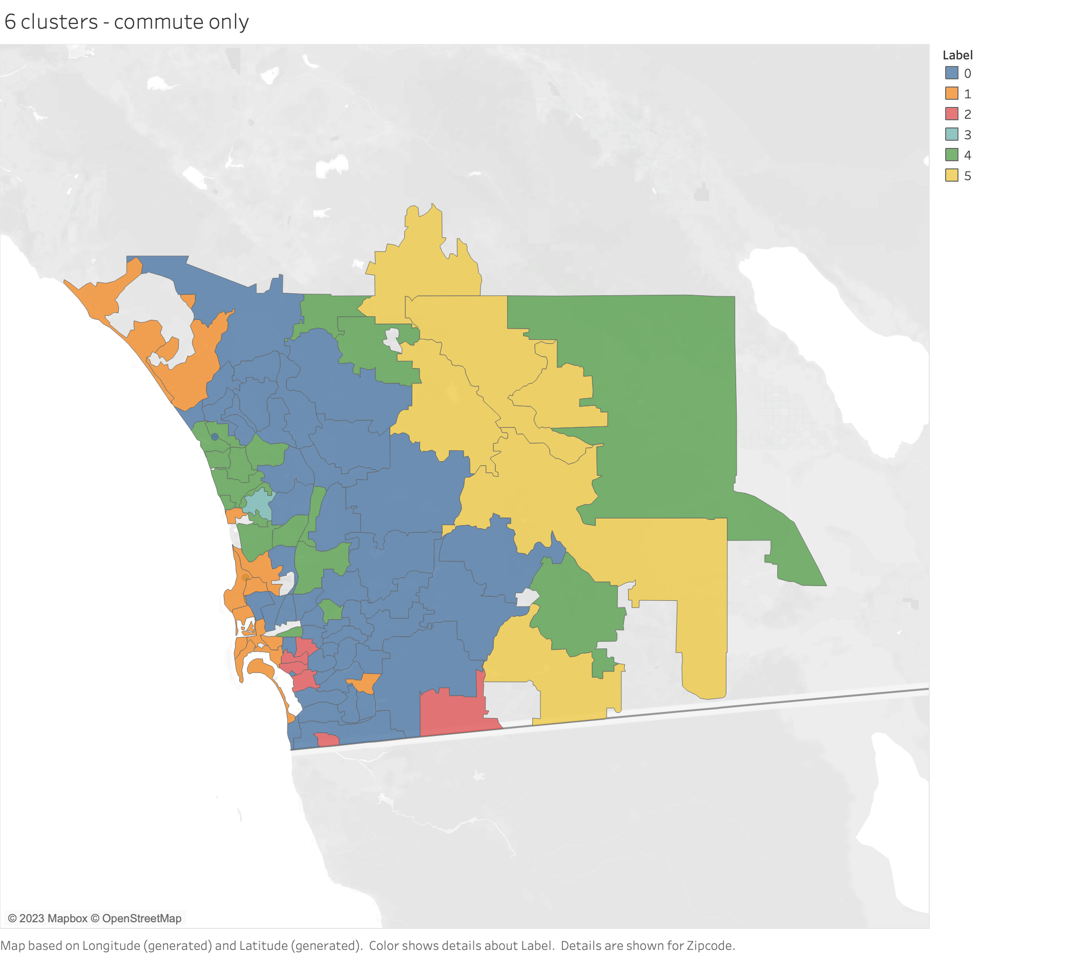

Slide 6
